Slide 1
Causal Model and Analysis of Path Model
Regression Analysis and Non-Linear Models: Sociology 6100

Slide 2
Pearson Correlation (r)
e.g. Academic performance and IQ
Educational attainment and income
Correlation does not explain causality
e.g. Bell-Curve
Race ----- Intelligence (IQ) ----- Economic success (occupational prestige)

Slide 3
Causal Model

Slide 4
Causal Model (cont.)

Slide 5
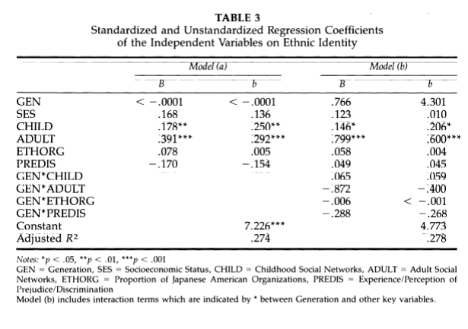
Examples of Interaction Terms and Path Model

Slide 6
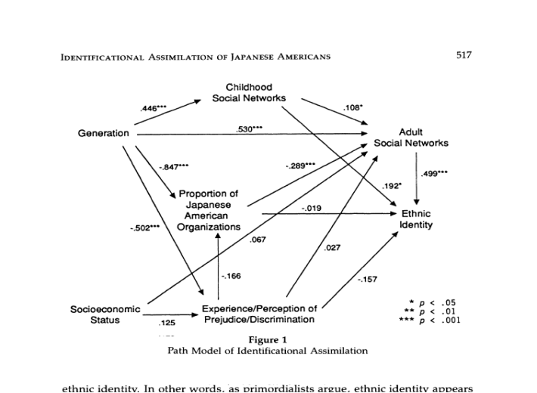
Examples of Interaction Terms and Path Model (cont.)

Slide 7
Path Model: Structural Explanation of the Number of Children and Other Explanatory Variables

Slide 8
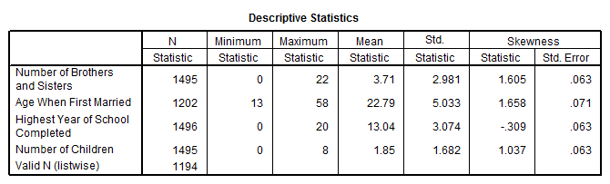
Path Model: SPSS Data Outputs
GET
FILE='C:\Program Files\SPSS\GSS93 subset.sav'.
DESCRIPTIVES
VARIABLES=sibs agewed educ childs
/STATISTICS=MEAN STDDEV MIN MAX SKEWNESS .
Descriptives
CORRELATIONS
/VARIABLES=sibs agewed educ childs
/PRINT=TWOTAIL NOSIG
/MISSING=PAIRWISE .

Slide 9
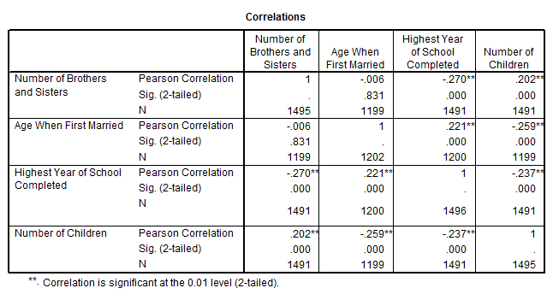
Path Model: SPSS Data Outputs (cont.)
Correlations

Slide 10
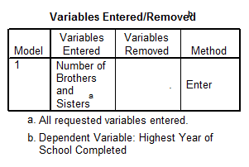
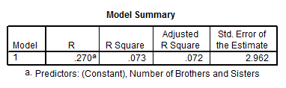
Path Model: Regression Model 1
REGRESSION
/MISSING LISTWISE
/STATISTICS COEFF OUTS R ANOVA
/CRITERIA=PIN(.05) POUT(.10)
/NOORIGIN
/DEPENDENT educ
/METHOD=ENTER sibs .
Regression 1: Education = α + β₁ Number of Sibs

Slide 11
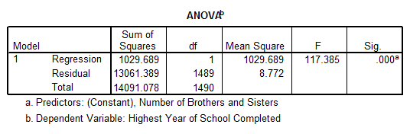
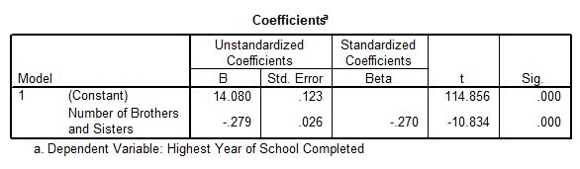
Path Model: Regression Model 1 (cont.)
Regression 1: Education = α + β₁ Number of Sibs

Slide 12
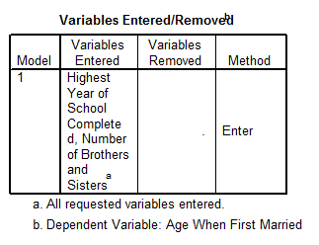
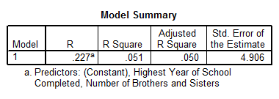
Path Model: Regression Model 2
REGRESSION
/MISSING LISTWISE
/STATISTICS COEFF OUTS R ANOVA
/CRITERIA=PIN(.05) POUT(.10)
/NOORIGIN
/DEPENDENT agewed
/METHOD=ENTER sibs educ .
Regression 2: Age Married = α + β₁ Number of Sibs + β₂ Education

Slide 13
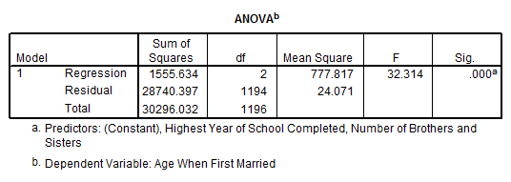
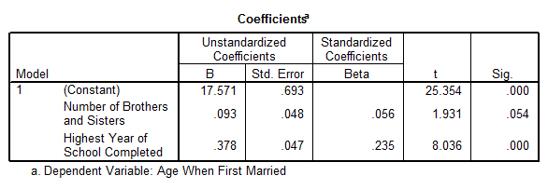
Path Model: Regression Model 2 (cont.)
Regression 2: Age Married = α + β₁ Number of Sibs + β₂ Education

Slide 14
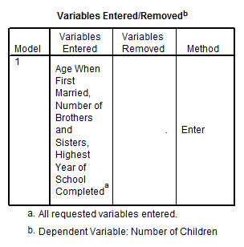
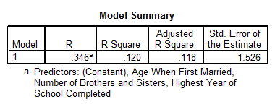
Path Model: Regression Model 3
REGRESSION
/MISSING LISTWISE
/STATISTICS COEFF OUTS R ANOVA
/CRITERIA=PIN(.05) POUT(.10)
/NOORIGIN
/DEPENDENT childs
/METHOD=ENTER sibs educ agewed .
Regression 3: Number of Children = α + β₁Education + β₂ Number of Sibs + β₃ Age Married

Slide 15
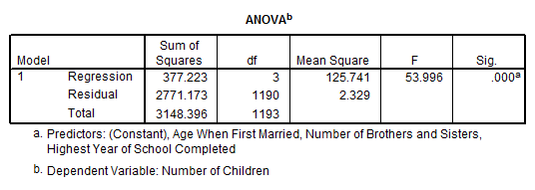
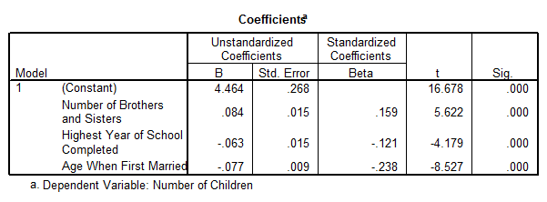
Path Model: Regression Model 3 (cont.)
Regression 3: Number of Children = α + β₁Education + β₂ Number of Sibs + β₃ Age Married

Slide 16
Tested Path Model with β Coefficients

Slide 17
Example of Direct, Indirect, Total, and Non-Causal Effects

Slide 18
Example of Direct, Indirect, Total, and Non-Causal Effects (cont.)
1. Total Association (Correlation) | 2. Direct Effect on # of Child | 3. Indirect Effect | 4. Total Effect | 5. Non-Causal Effect
0.202 | # of Sibs (0.159) | Via Age Married (0.056) (-0.238) = -0.016 Via Education (-0.270) (-0.121) = 0.033 | 0.175 | 0.027

Slide 19
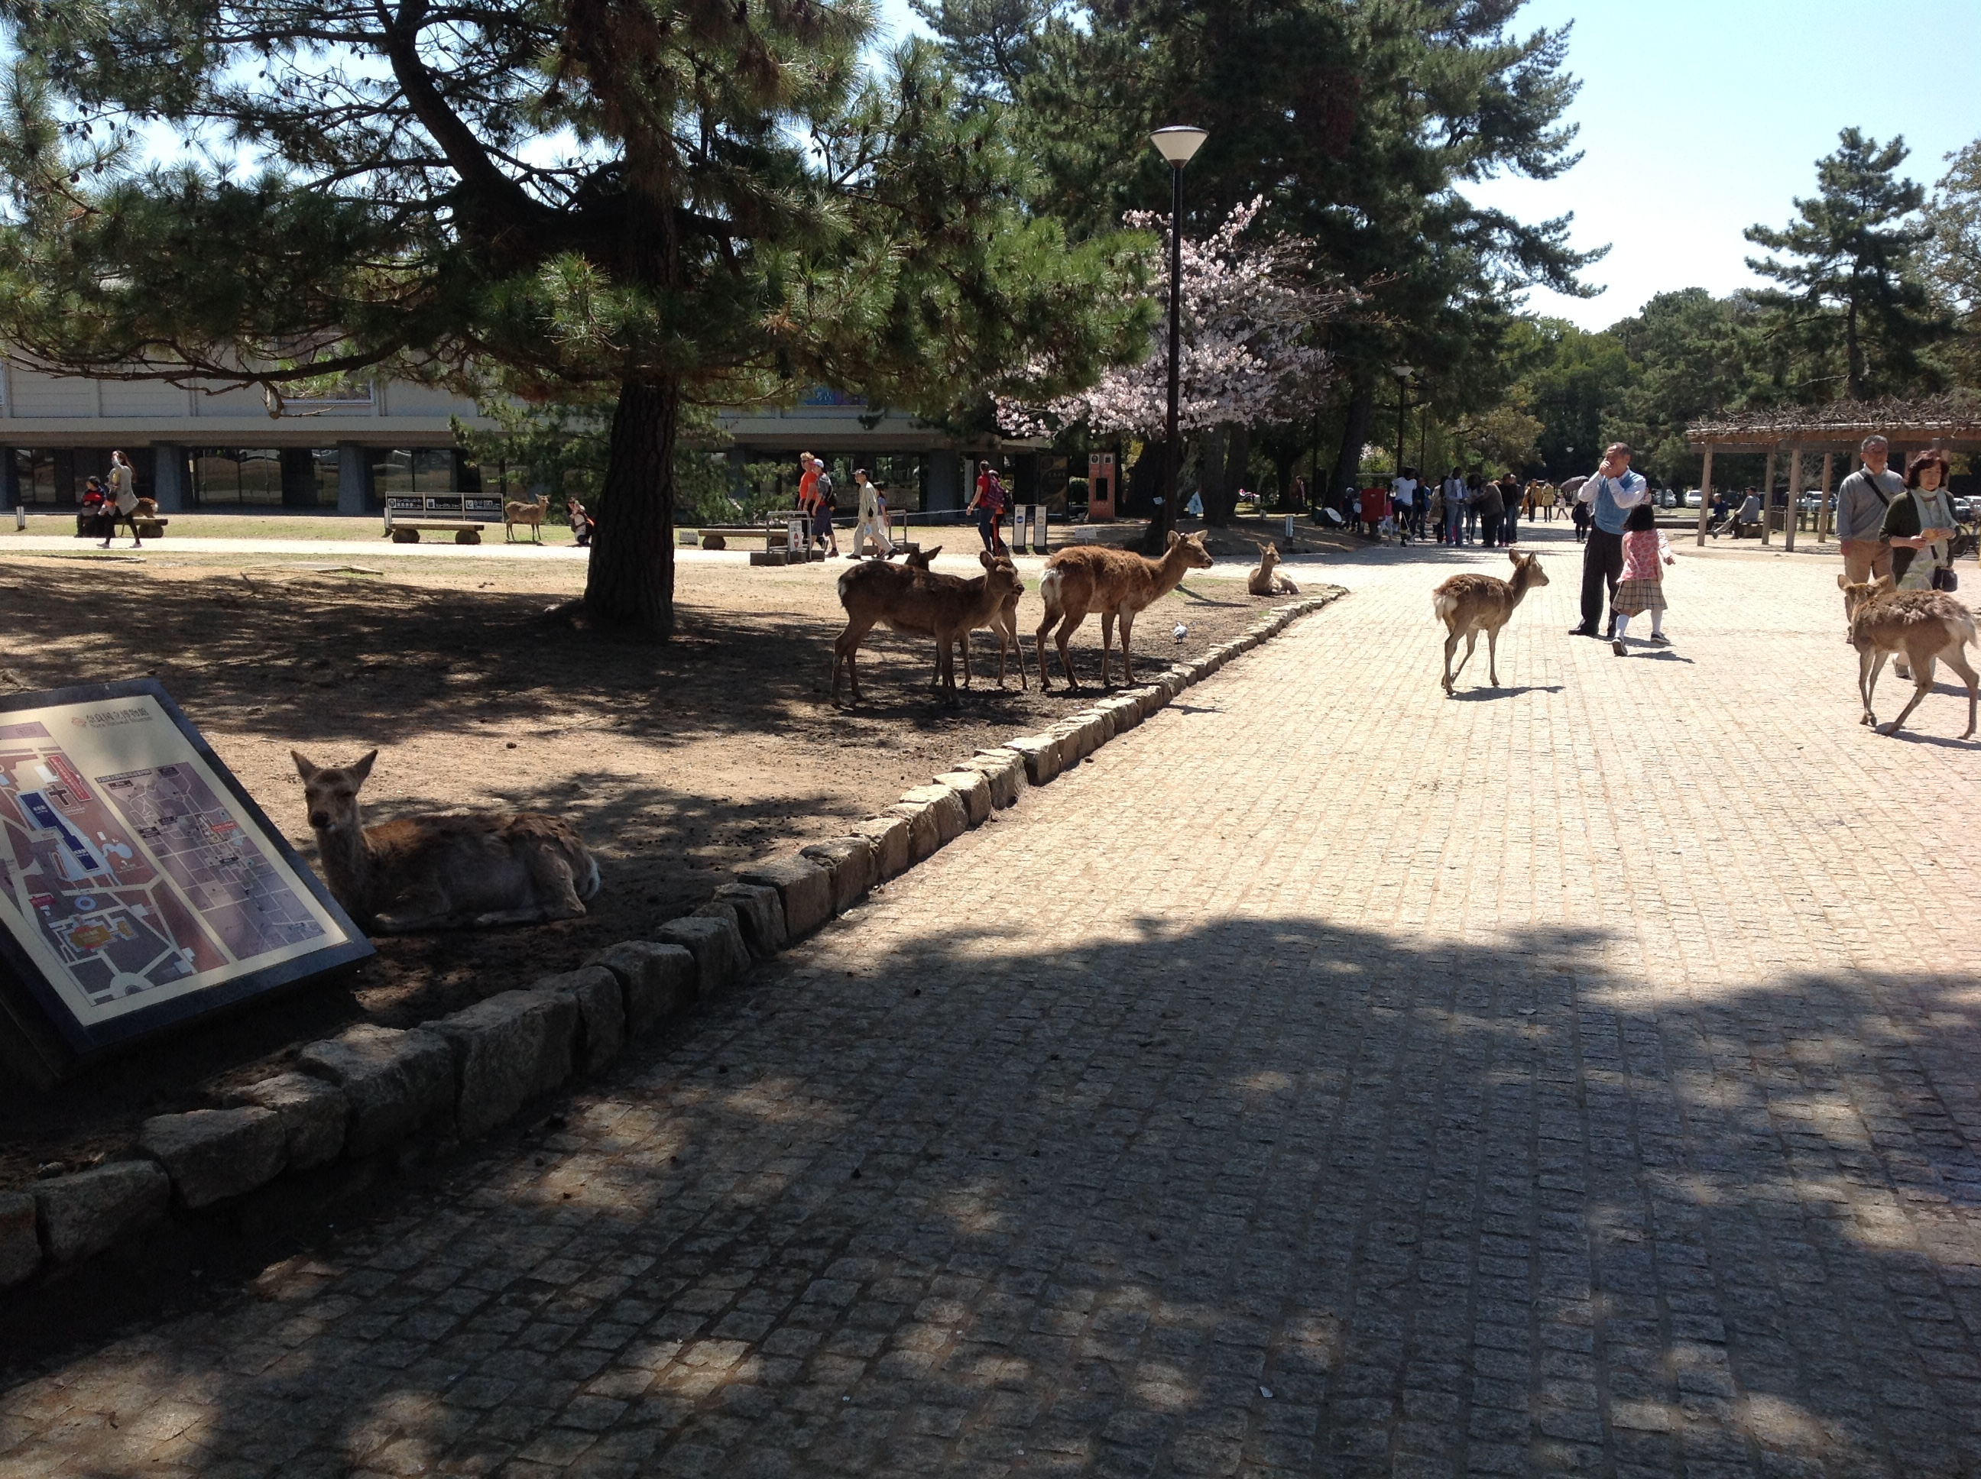
Let’s Try!

